Slide 1
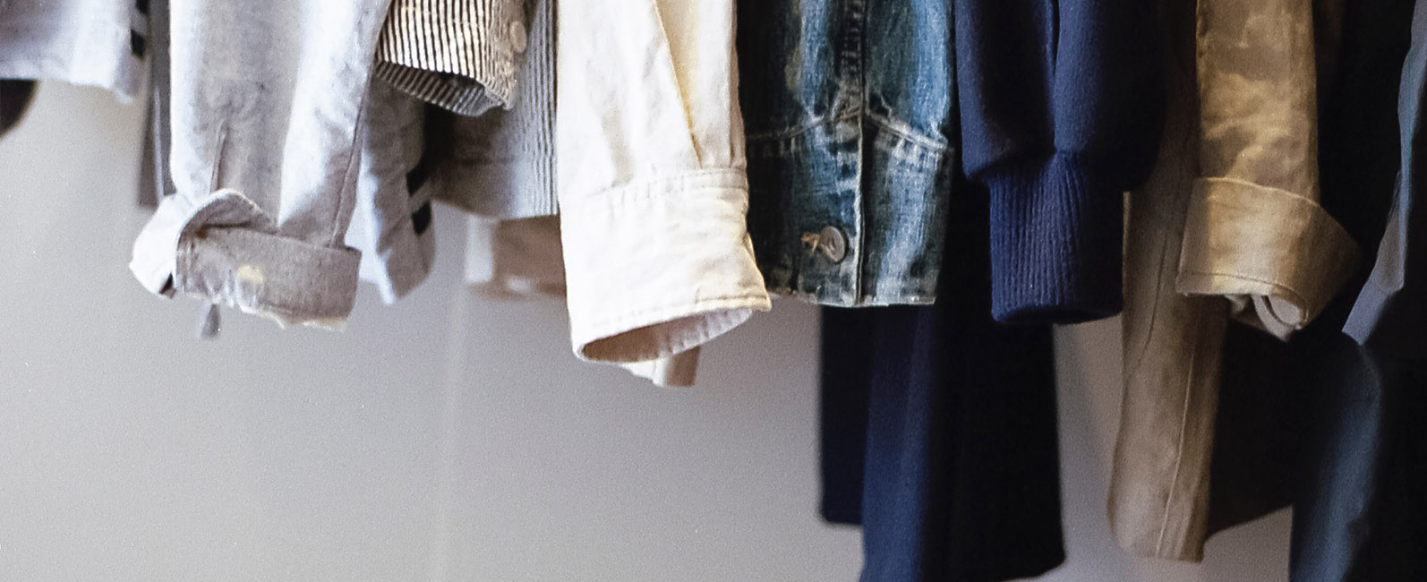

FASHUP
PROJECT PRESENTATION

Slide 2
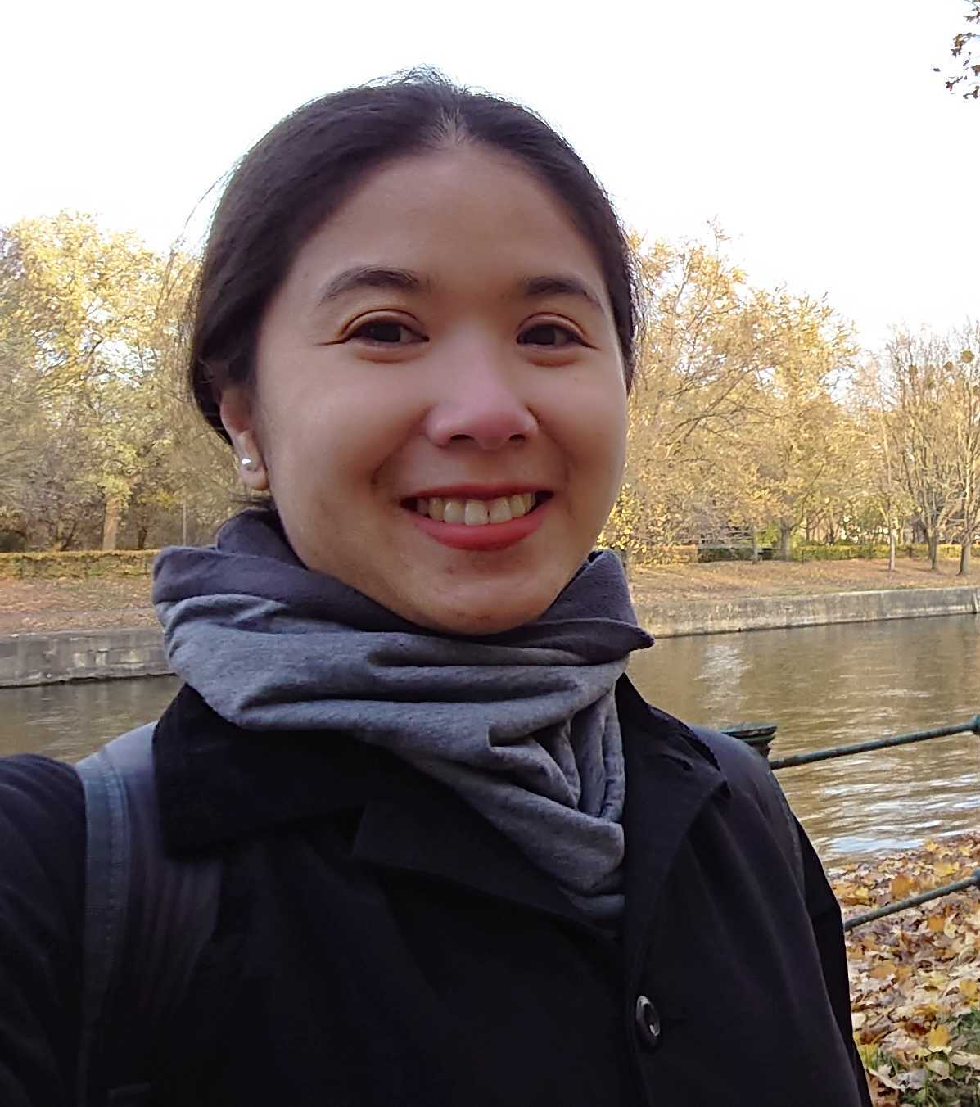
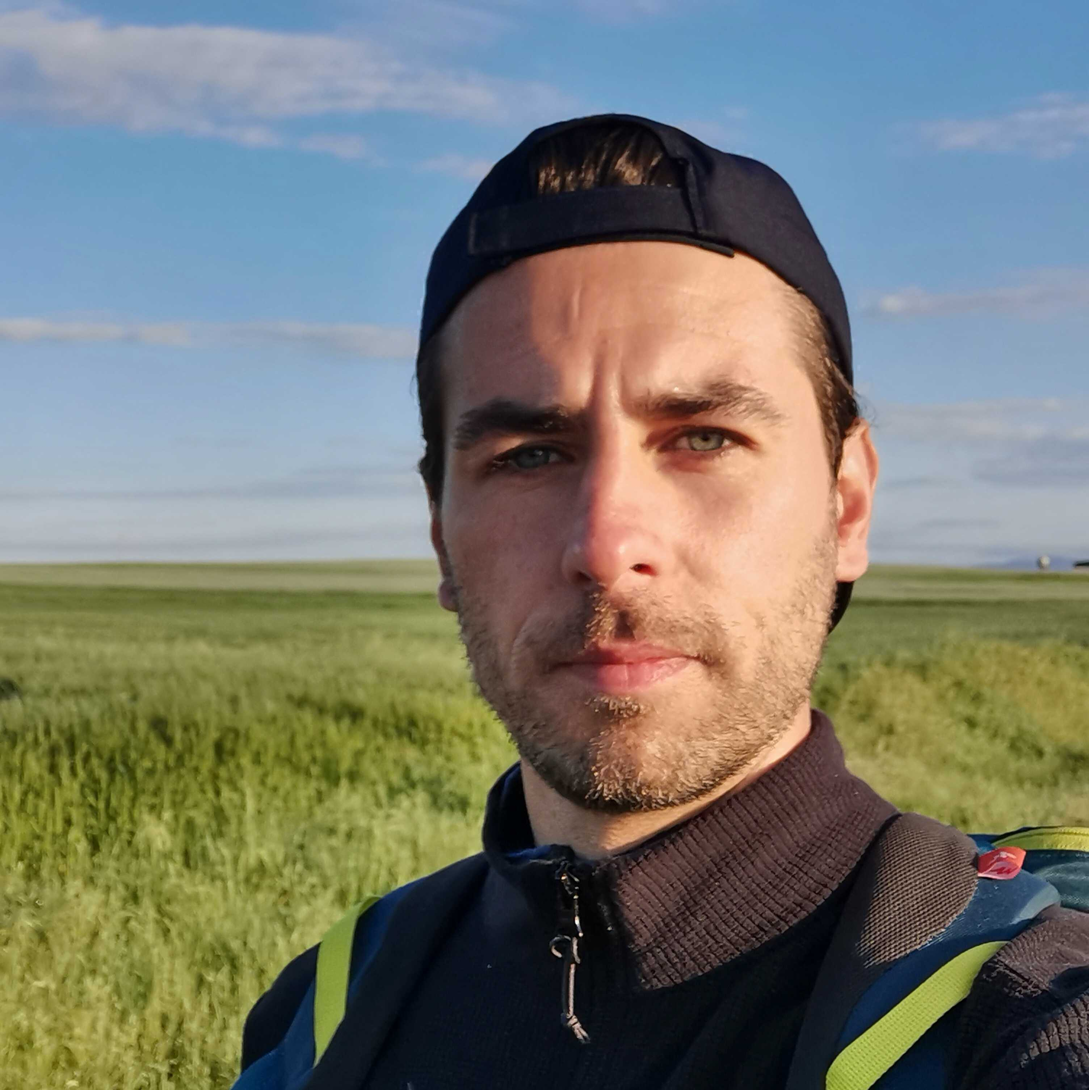
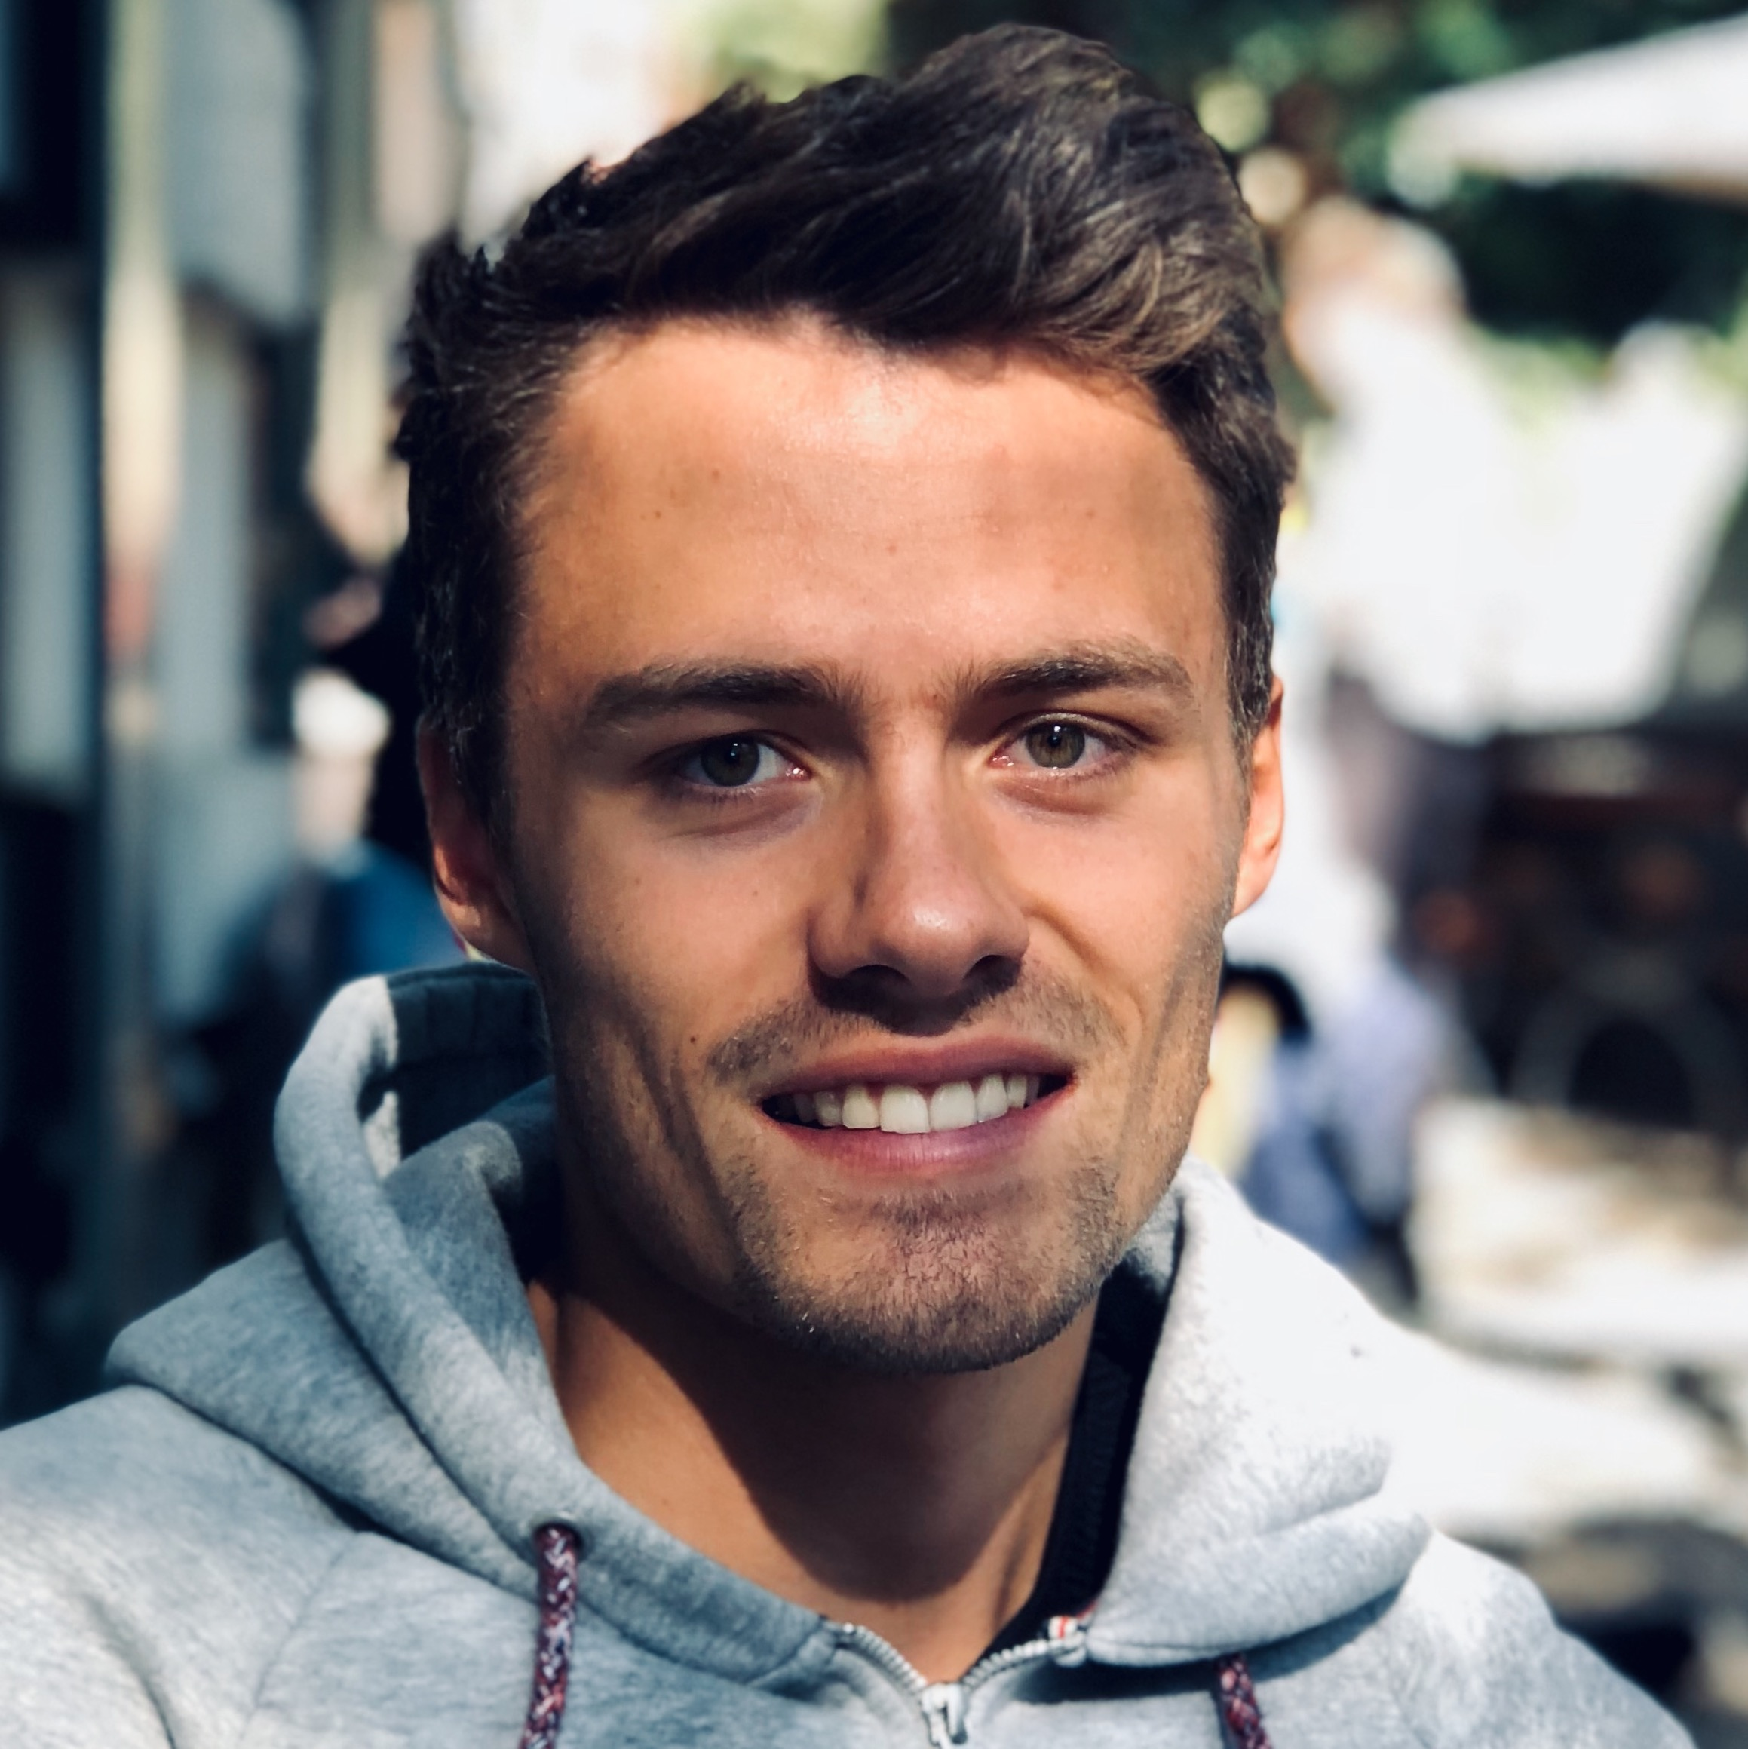

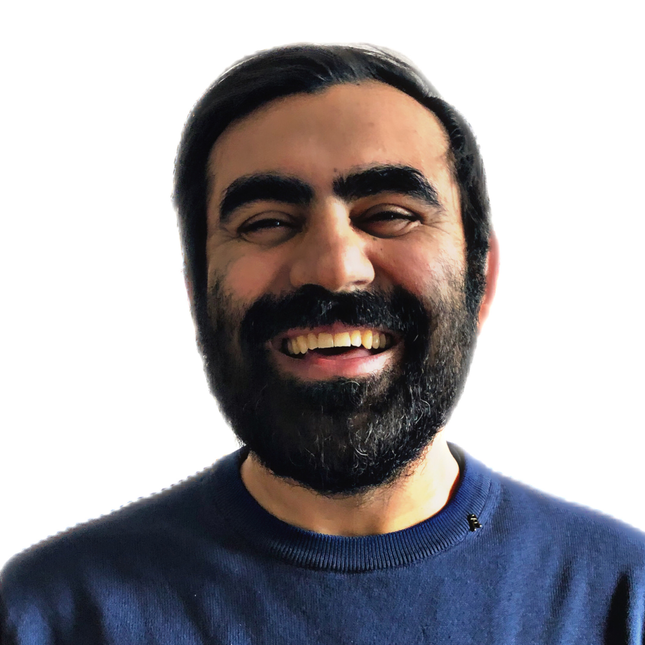
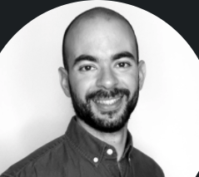
FASHUP
MEET OUR TEAM
UX/UI
WD
AI
Mentor
SIRAPRAPA CHALERMPHAO
ROMAN WIEGEL
LUKAS BAUERSCHMIDT
BOGDAN CIOBOTARU
User Research |
Design | Test
Web Development | Frontend
AI Model | Backend
Project Mentor
CEM AKBULUT
FABIAN BARULLI
Project Management | Frontend
AI Model | Scraping
Notes:
● Hi together, and welcome to the pitch of our team. We developed a solution in the second hand clothing market
● Our team consisted of
1.) Sira as our UX/UI Designer
2.) Roman and Cem as our Front-End Web Developers
3.) Fabian and Me as Back-End AI Developers
4.) and finally Bogdan as our Project Mentor
● Let's kick it off.

Slide 3
1
FASHUP
Business Problem &
Research

Slide 4
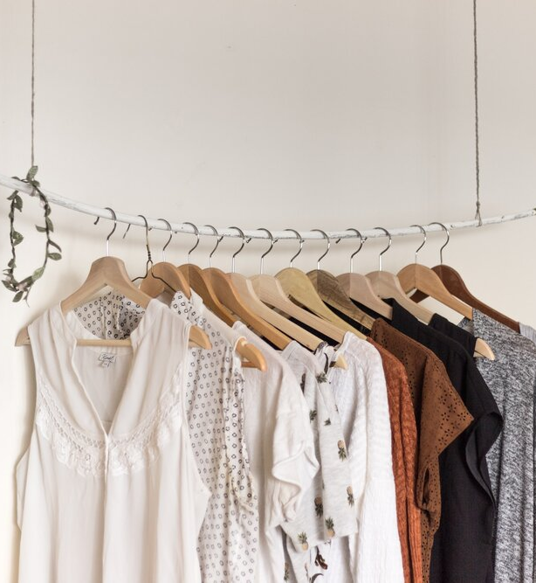
FASHUP
PROBLEMS
FASHUP’S ANALYSIS FOUND OUT THAT CUSTOMERS INCREASINGLY FACE PROBLEMS LIKE ...
FRAGMENTED
SUPPLY
TIME CONSUMING
2nd HAND SHOPPING
Vinted, Depop, Vestiaire Collective, ThreadUp, Stationary Retail
Browsing multiple platforms to find matching outfit
NO PERSONALIZED
SUGGESTIONS
INFLATED
PRICES
Not addressing customer need of matching customer outfits
Rising inflation drives consumer prices:
2021: 3.1%
Notes:
● At the beginning of our project phase, our team had an intense brainstorming session about nowadays second hand shopping
● We identified 4 major problems:
1.) First, there seems to be a fragmented supply, meaning there are several plattforms offering second hand clothes
2.) This implies that second hand shopping is time consuming, since users need to browse through multiple plattforms to find the right clothing items
3.) Thirdly, most of these second hand websites do not offer personalized suggestions
4.) And lastly, due to the current inflation, prices of new clothing items seems to rise significantly
● But before we started creating a product, matching these problems, we tried to better understand the market we aimed to penetrate as well as its consumer.

Slide 5
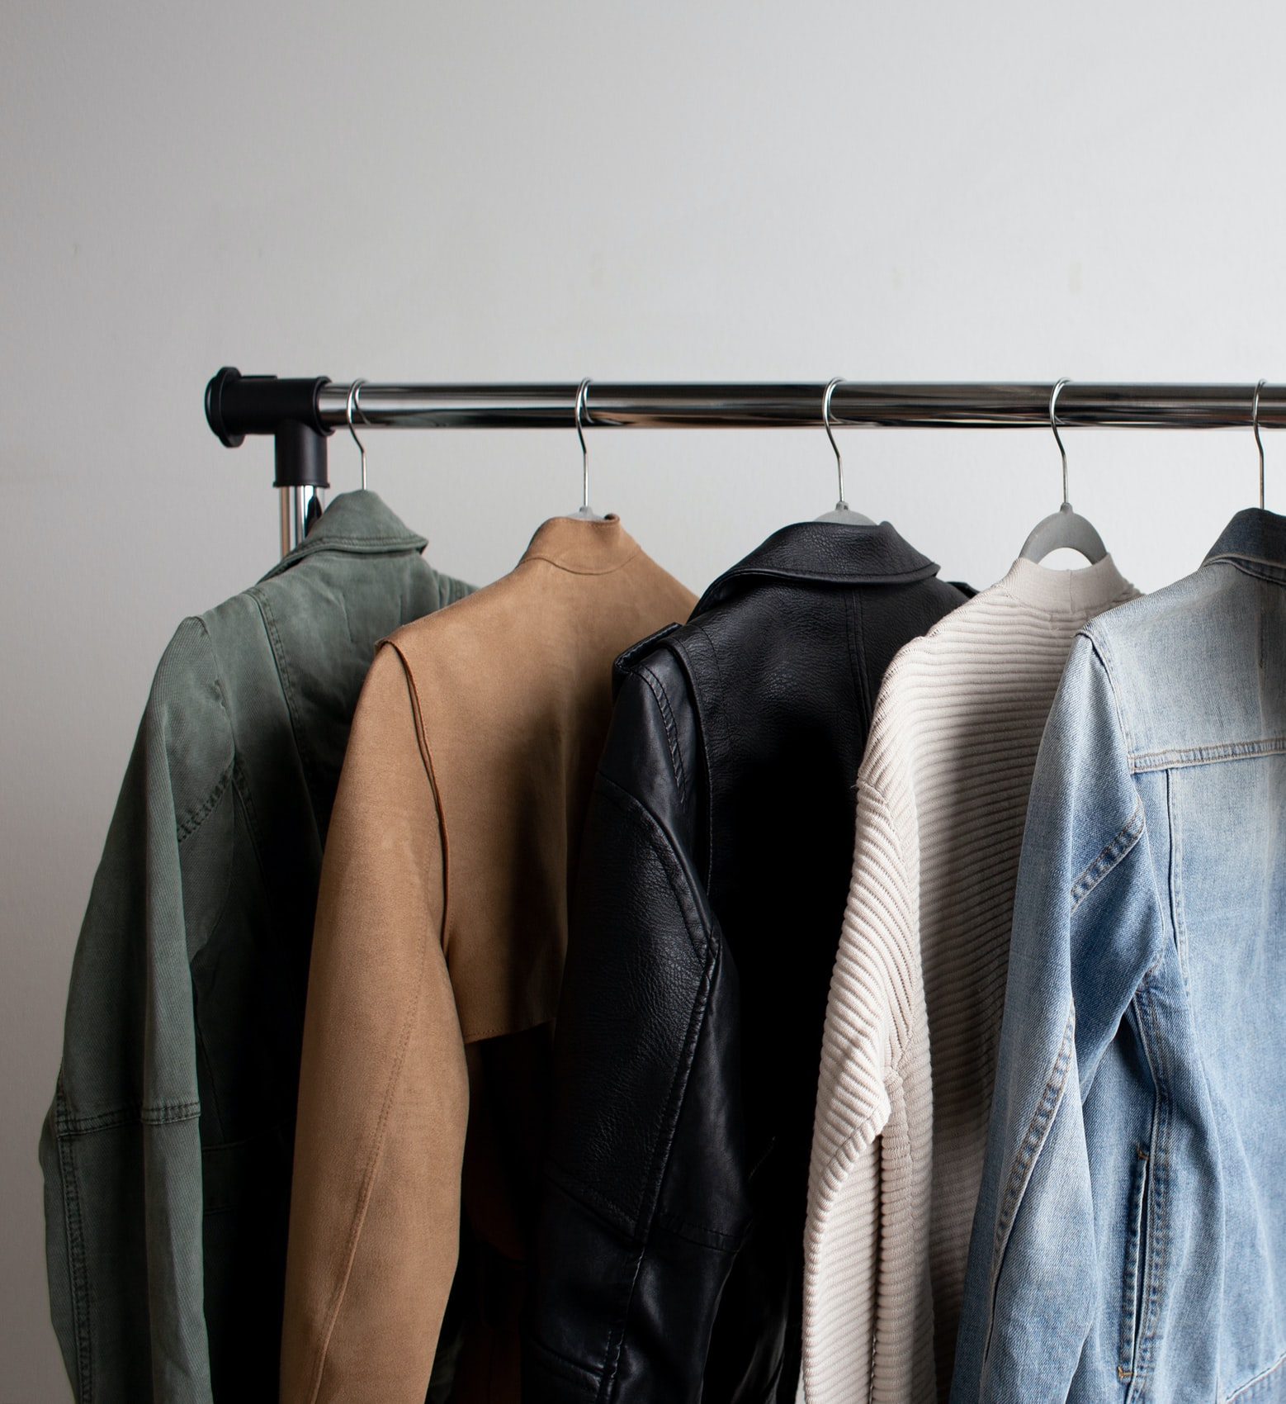

FASHUP
RESEARCH
FASHUP’S USER RESEARCH YIELDS SAME RESULTS AS MARKET RESEARCH, WHICH INCLUDES ...
2ND HAND
MARKET TREND
2ND HAND
MARKET GROWTH
Increasing 2nd hand fashion supply and demand since it is greener and cheaper
Market Growth 15%-20%
From 30 Billion to 80 Billion in the next 5 years
Notes:
Therefore we conducted both
1) A market research
2) user surveys.
● And luckily, the results of both analysis were consistant!: And they showed that
1.) First there seems to be an increasing trend towards 2nd hand shopping
2.) Second, the second hand market is predicted to grow from 30bn dollars to 80bn dollars in the next five years
● So this shows, that there is indeed both 1) a consumer need as well as 2) promising market growth wherefore we decided to develop our FashUp plattform

Slide 6
2
FASHUP
Solution &
Technology Stack

Slide 7

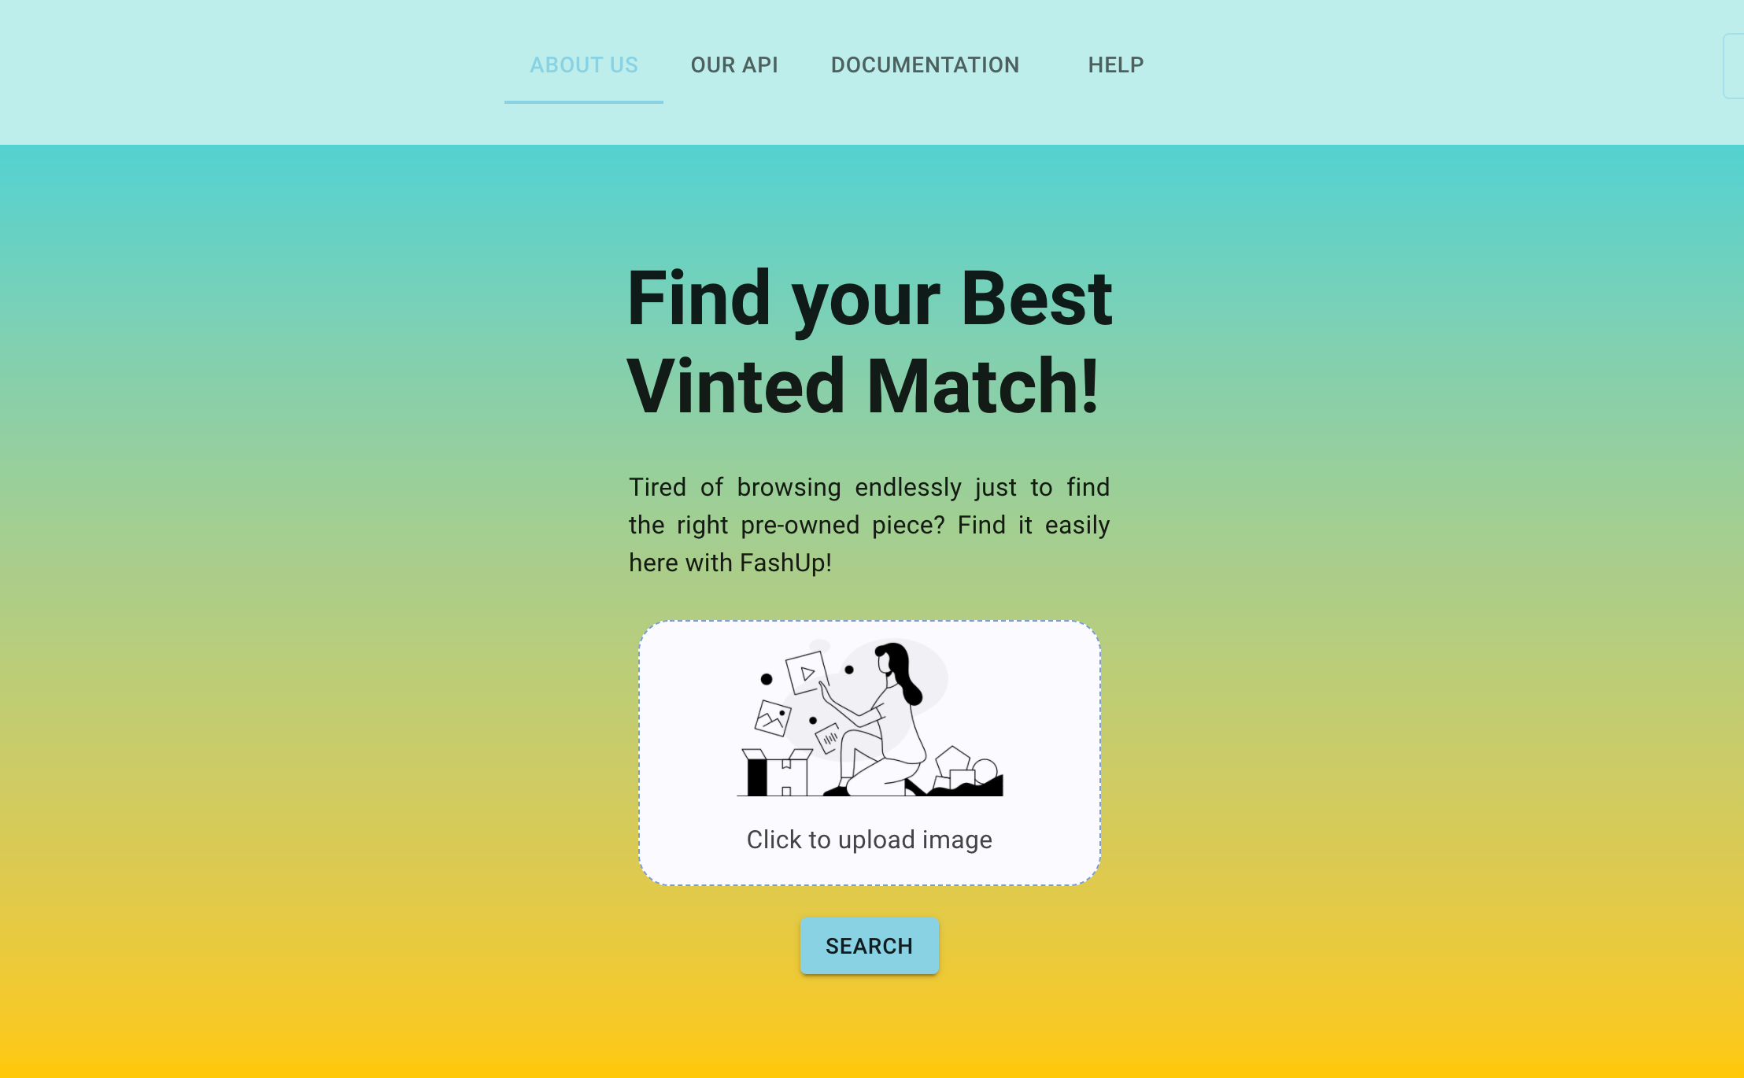
FASHUP
FIND YOUR BEST SECONDHAND MATCH
An aggregated solution that allows the end-user (~15-25 years old) to upload his/her favorite clothing item and to quickly find the most personalized second hand item.
Step 1: Upload a single picture with your favorite clothing item
Step 2: Click on “Search” & FASHUP suggests 4 most similar items
Step 3: Research your favorized item & navigate to online shop
Notes:
● We as Fashup found a solution that allows the end-user to upload his/her favorite clothing item and to quickly find the most personalized second hand item
● And here comes how it works:
1.) First: You upload you picture f your favorite fashion item. This could be for instance a photo of a clothing item that is out of market already or a clothing item that for instance is too expensive in the first place
2.) Second: You click on search and FASHUP immideatly suggests the best matching second hand items. For this purpose, Fashup relies on the data of the vinted.com website.
3.) Third: You can now directly click on the item link and and shop your best suited and personalized second hand item on the vinted.com website

Slide 8
3
FASHUP
Key Learnings & Future Outlook

Slide 9
FASHUP
FASHUP PROMISES FURTHER FUNCTIONALITY IN THE FUTURE
COMPLEMENTARY FEATURE
USER MANAGEMENT
FASHUP ECOSYSTEM
Develop and implement user accounts
Integrate tailors, designers & stationary retail
Provide complementary fashion items
MVP
ENHANCE AI
MODEL
MOBILE APP
MULTIPLE PLATFORMS
Train AI Model on DeepFashion Database
Develop an app for mobile devices
Enlarge database (Depop Vestiaire, Collective, ThreadUp)
Notes:
● Diving deeper into the future outlook. We additionally identified 6 areas, in which we would like to enhance our solution in the future
● First, we want to enhance the AI model by retraining it on a Fashion Only Database
● Second, we would like to add a second feature to our application: With this feature, users should be provided with complementary fashion items, meaning if you upload a pullover you do not get displayed a machting pullover but rather a matching pair of jeans or sneakers
● Then, we would like to develop the official Fashup mobile application, to better reach our target customers
● Also, we would like to implement a user management functionality incl login
● Then, we would like to enlarge our database, meaning not only relying on vinted.com but also other plattforms
● And lastly, we would like to build an ecosystem, bringing together multiple partners like designers, tailors and stationary retail

Slide 10

Project Management
Agile Work Structure
Technology Know How
Tools, Communication Channels,
Organizing Work, Task Clarity, Track Transparency, Commitment
Fast Paced Project Environment, Changed MVP, Changed Design & Layout several Times, Adapted AI Model
Steep Learning Curve, Cross Technology
Know How,
Adaptive Learning
FASHUP
Challenges & Successes
Notes:
● Coming to our success stories & challenges
● First during the project management, we faced some difficulties in the beginning concerning track transparency and task clarity, but this enhanced significantly towards the end of the project phase
● Additionally we needed to get comfortable with an agile MVP development approach, but managed to quickly adapt to changing circumstances
● And finally, I think I am speaking for all of our team members we had such our up and downs
a steep learning curve during the course of the project and are super thankful for this amazing experience.
● We want to show you right now a demo of our FASHUP plattform.

Slide 11
5
FASHUP
Demo

Slide 12
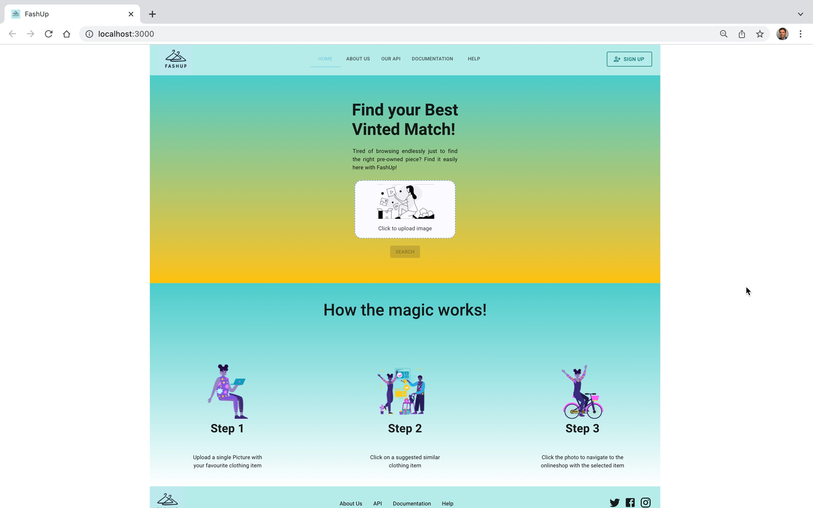
Notes:
● We divided the website into the sections
A) Home
B) About Us
C) Our API
D) Documentation
E) and Help
● Jumping into our main function:
1.) We start by choosing an item we want to have a similarity recommendation on
2.) We then click on search
3.) And Fashup finally suggests us similiar looking items. We now can research our favorized item, navigate to online shop & start shopping
● We continue with another example, in this case we choose these winter shoes for women
● We again click on search and get recommended similar looking items.
● We again browse to the website and start shopping our favorized item
● Thats it.
● We hope you enjoyed our presentation and we are more than welcome to answer any questions

Slide 13














FASHUP
WD
FASHUP
FASHUP
UX/UI
AI
FASHUP
Making Second Hand Shopping Quick and Convenient!
Notes:
● We hope you enjoyed our presentation and we are more than welcome to answer any questions

